Slide 1
RandAugment Practical automated data augmentation with a reduced search space
Cubuk, Zoph, Shlens, Le
Googe Research, Brain Team
Presented by William Guimont-Martin
2024-04-03

Slide 2
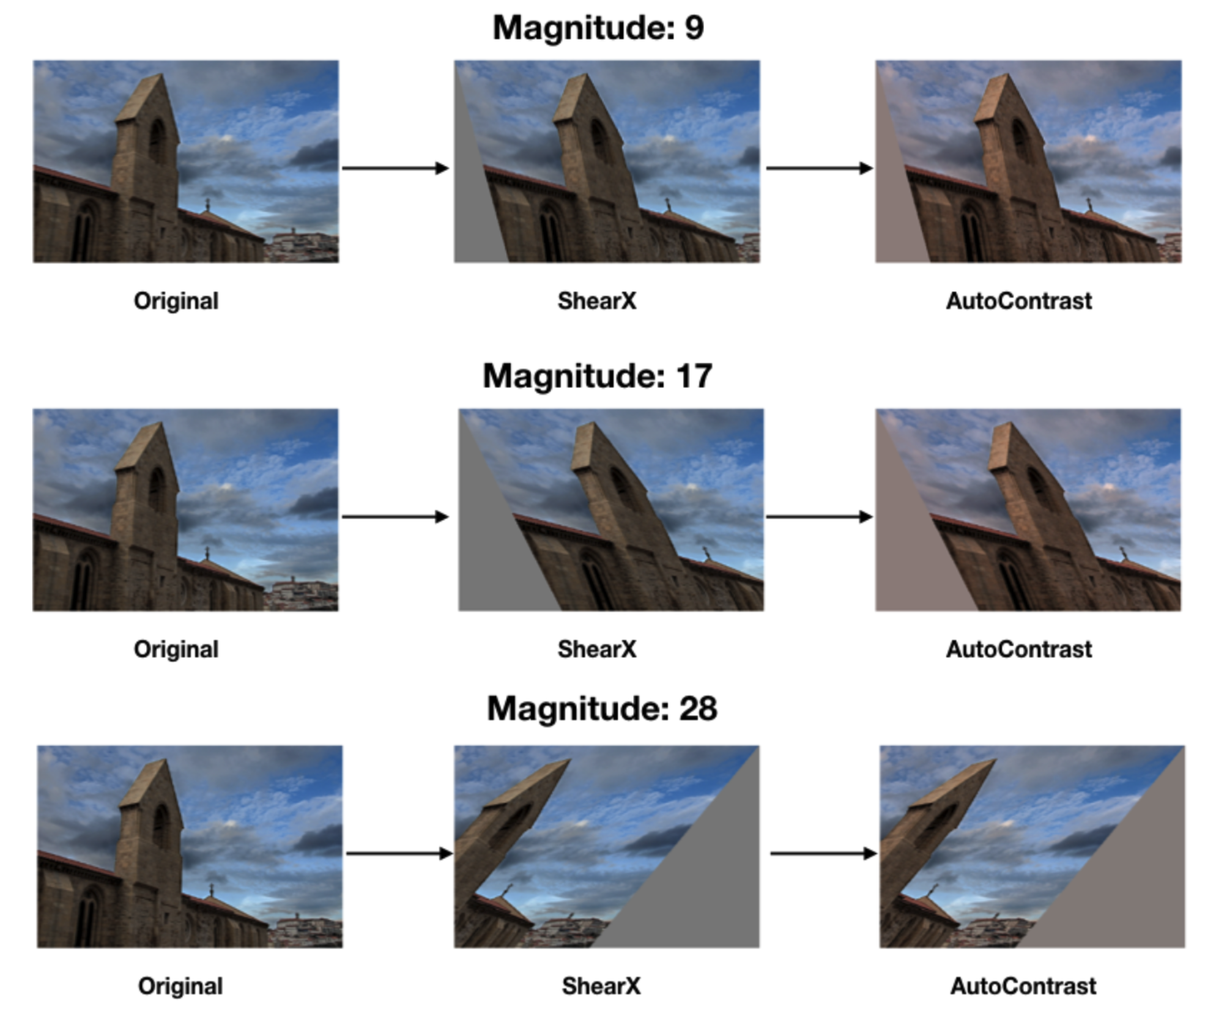
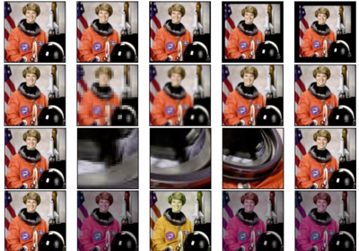
Data Augmentations
Increase the diversity of training data
Act as regularization
Require expertise and manual work to design
Depend on the network and dataset
https://pytorch.org/vision/stable/_images/sphx_glr_plot_transforms_illustrations_thumb.png
Notes:
Crucial to deep learning
Improve diversity, generate new samples at training time
Regularization → improve generalization and performance
Expertise and tuning
Depends on a lot of parameters
What transform
What probability
What magnitude
Depends on the network and dataset

Slide 3

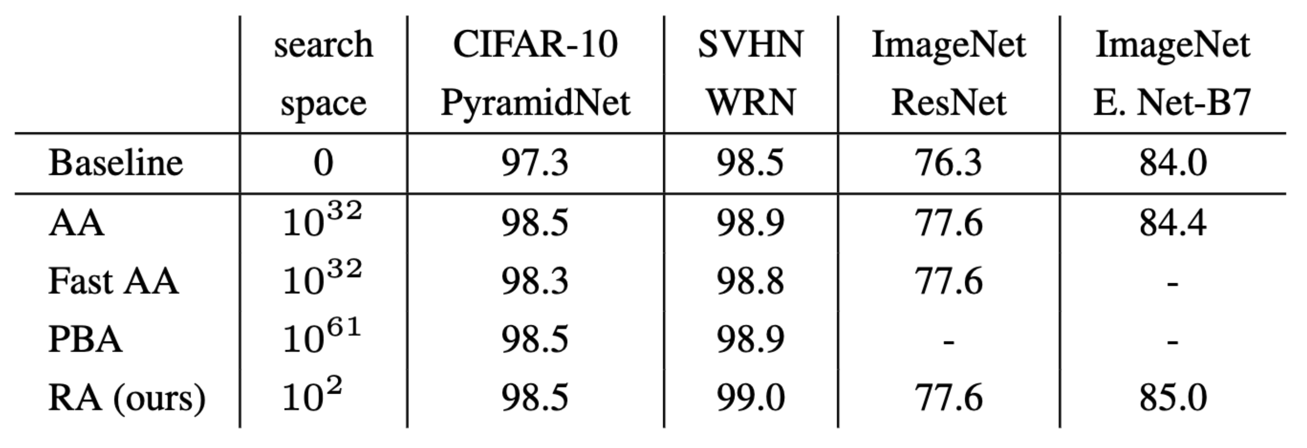
Automatic Data Augmentation
Learning data augmentation policies
AutoAugment (Cubuk et al., 2019)
Population Based Augmentation (Ho et al., 2019)
High computational cost and complicated procedures
Often use proxy tasks
Notes:
Can instead use learned policies
Lean how to augment
AutoAugment
RL to optimize for the best transform
PBA
Set of networks trained with different parameters for augmentation
Prune worse performers
Optimize for an augmentation schedule
Still methods with a lot of parameters
Large search space
High computation and optimization procedures
Therefore, use proxy tasks (small network, dataset subset)
Realized that the use of proxy task uses an assumption that’s not true
Transferability between model and dataset size is false
Not true optimal transforms
RA
Reduce search space
Not rely on proxy tasks
Achieve competitive or better performances

Slide 4
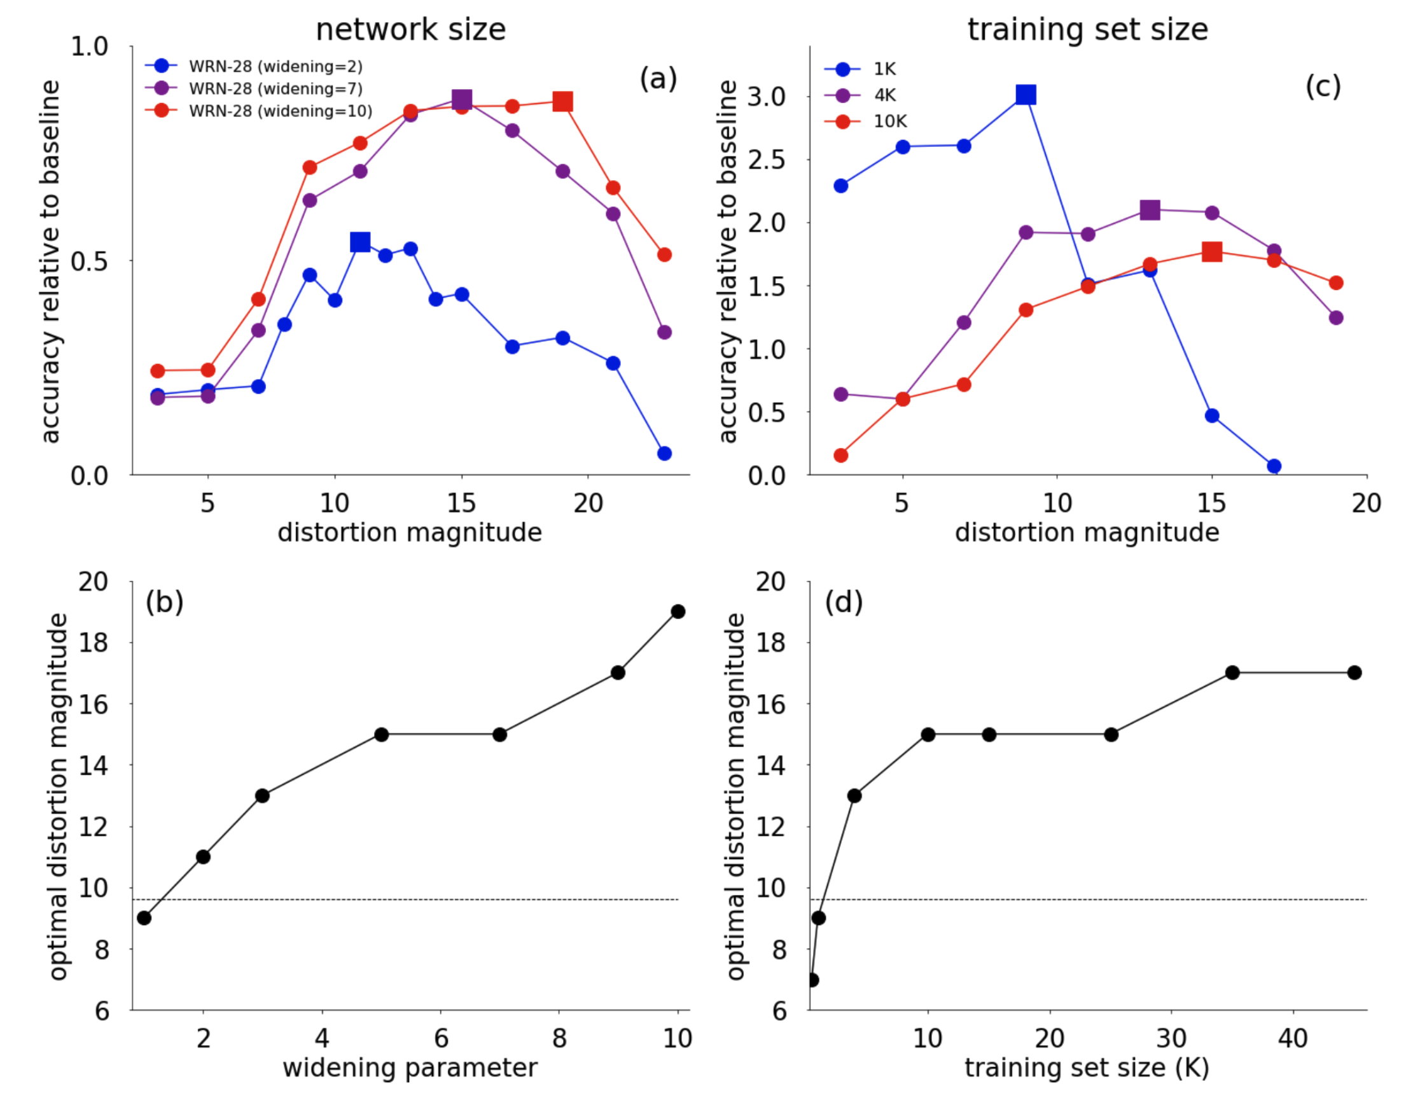
Challenging the proxy task assumption
Network size and dataset subsets
Notes:
Challenge proxy task
Study on network size and dataset subsets
Network size
Larger needs more
Regularization
Bottom plot, see that the best magnitude increases with widening
Does not transfer between network size
Same thing is true for the subset
Best magnitude changes with number of data
Larger datasets needs more
Small dataset leads to less signal-to-noise ratio
If we did our optim on small network and dataset subset
Won’t get the optimal values

Slide 5
RandAugment
Does not rely on proxy tasks
Small search space
No complicated optimization procedure
Notes:
Propose RandAugment
No proxy task as optimization is simple
Reduce search space
Simple grid search
Competitive or better performances

Slide 6
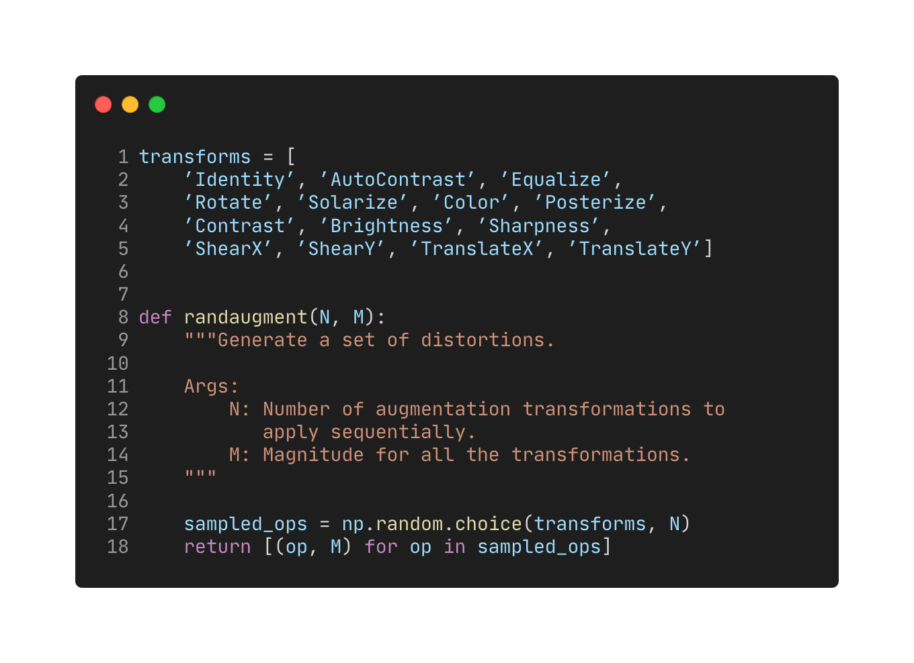
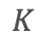

RandAugment
$$K$$
Augmentations
Two hyperparameters
Sample uniformly with replacement
( policies)
$$K^{N}$$
Same magnitude
Notes:
Code can fit in a slide
Simple
List of K augmentations
Only two hyperparameters
Only parameters to tune
Sample N transforms (leading to K^N possible augmentation pipelines)
Use the same magnitude for each transform

Slide 7
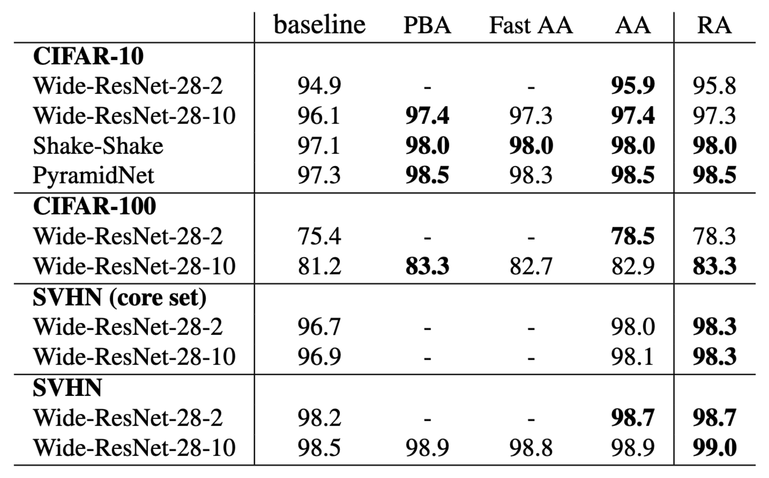
Results
Comparison with other approaches
Notes:
We are competitive with other approaches (0.1) or better
Use way less resource for optimization
Same list → not very sensible

Slide 8
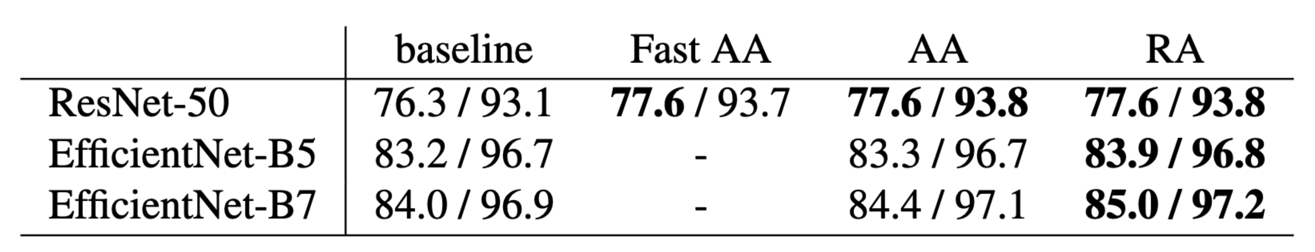
Results
Top-1 and Top-5 on ImageNet
AutoAugment does not help for larger models
Policy found on 10% of the dataset
Proxy not representative of the full dataset
SOTA accuracy in top-1
Notes:
Results for ImageNet Top-1 and Top-5
Compare with AA
While competitive on smaller networks
Don’t help much for larger
Maybe because the proxy task only used 10% of dataset
Not representative of the real task
We beat AA on larger networks
New SOTA for top-1 accuracy

Slide 9
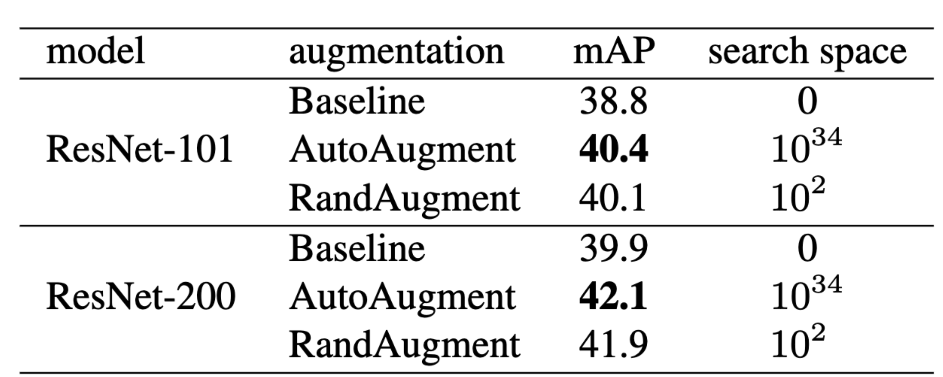
Results
COCO dataset for object detection
AutoAugment
Uses specialized augmentations for bounding boxes
Took 15k GPU hours
RandAugment is competitive without it
Searched over 6 values (N = 1, M = {4, 5, 6, 7, 8, 9})
Notes:
Also experiments on COCO for object detection
Also compare with AA
Uses specialized augmentations for bounding boxes
15k gpu hours
RA
Only 6 values
Still very competitive
Interesting tradeoff
Effect of each transform

Slide 10
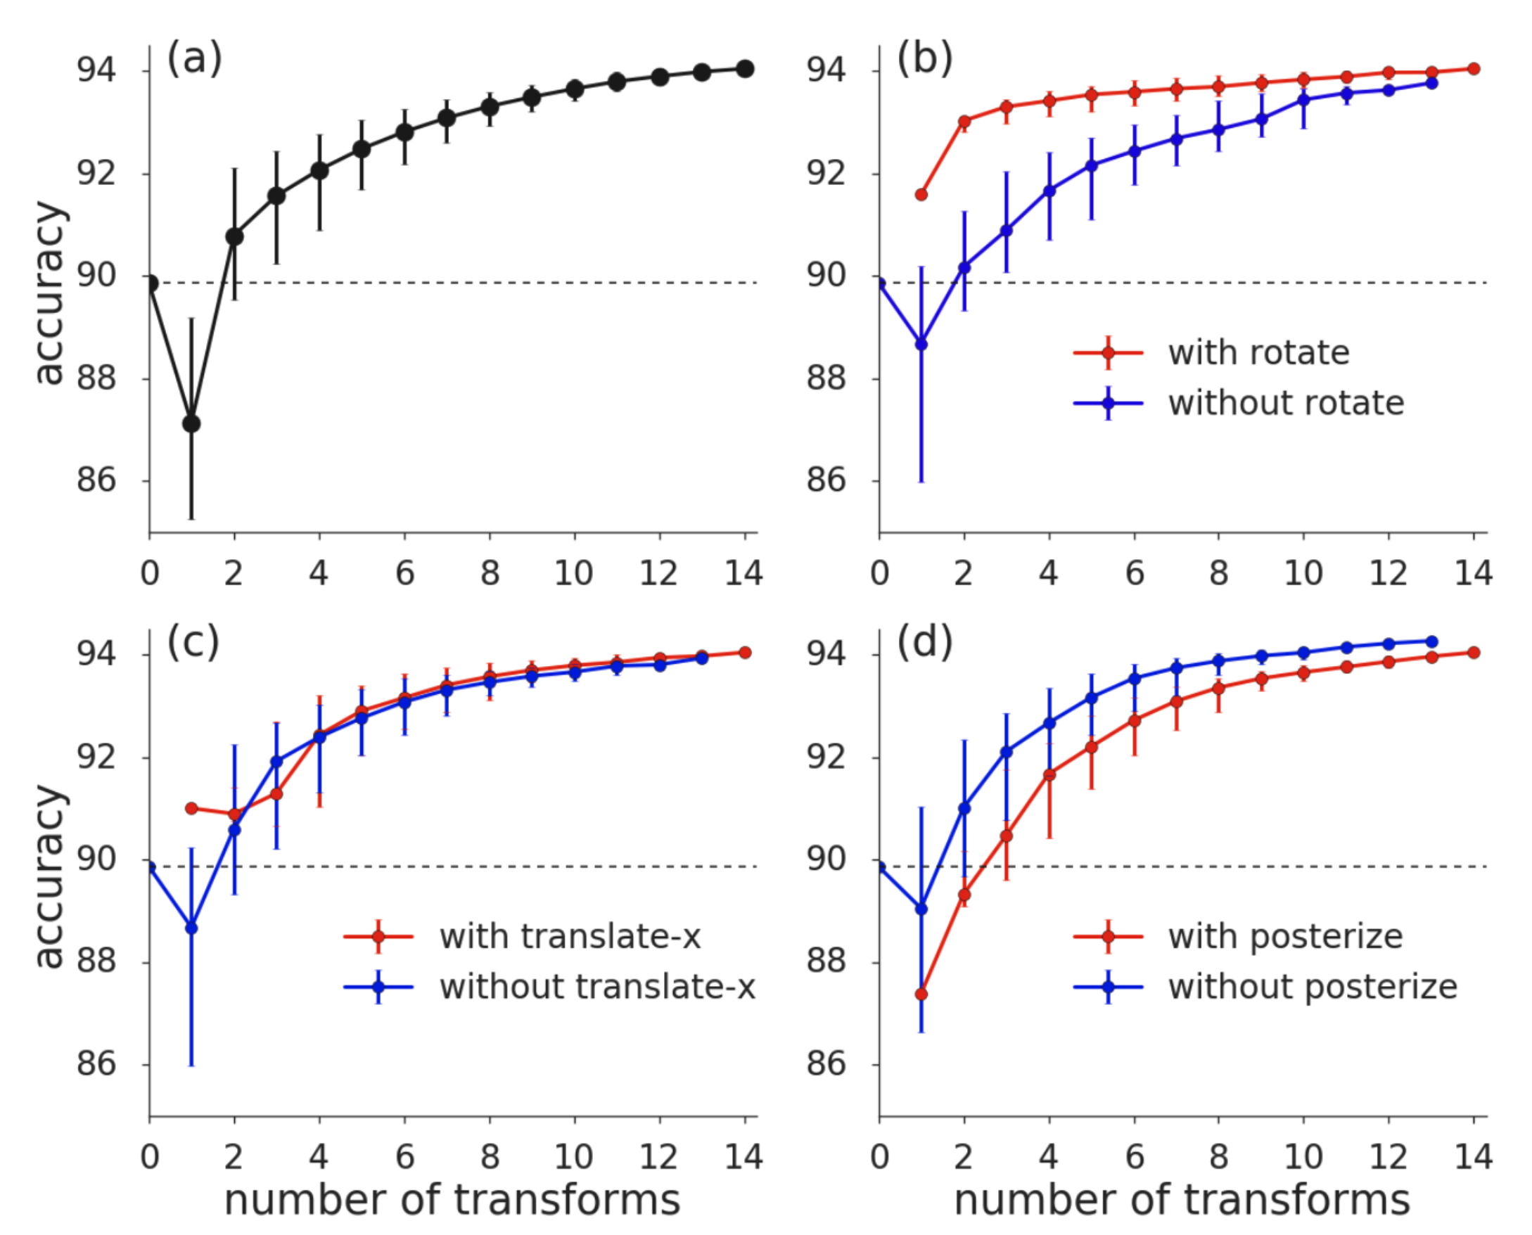
Results
Impact of included transformations
Notes:
Now that we know that RA has good results
Time to study it in more detail
Let’s start with the impact of included transforms
More is better in (a)
In the other plots, we see the impact of individual transforms when present or not to a random transform subset
Rotate is more important
Posterize has a negative impact, yet is useful when more transforms are used

Slide 11
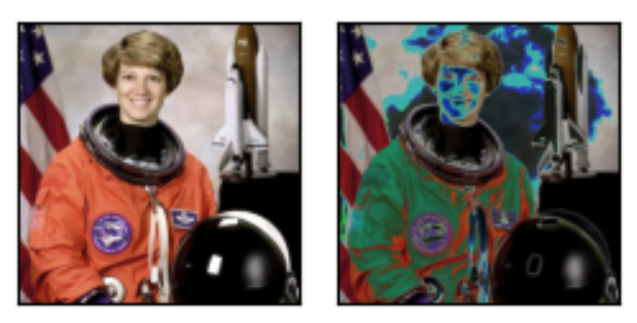
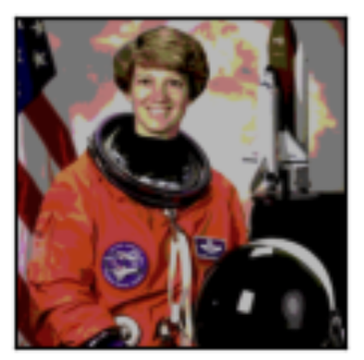
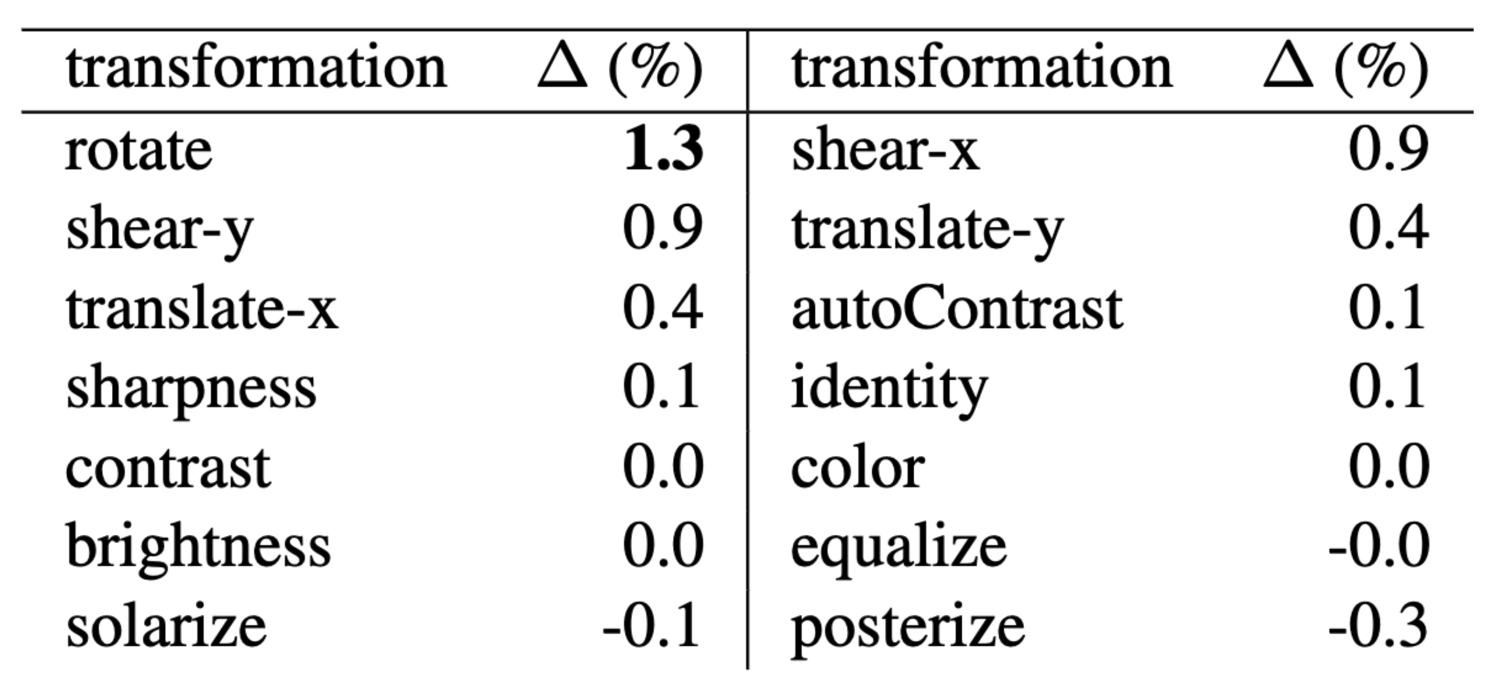
Results
Impact of included transformations
https://pytorch.org/vision/main/auto_examples/transforms/plot_transforms_illustrations.html
Notes:
Average effect on performance when added to a random subset of augmentation
Solarize and posterize are quite aggressive
Solarize = Invert pixels above a threshold
Posterize = reduce number of bits to encode color
- In general, more is better

Slide 12
Results
Learning the probability per augmentation
RandAugment samples uniformly N transforms
Can also set a different probability per transform
Most transformations are differentiable
backprop to learn the probability per transformation
Learn to maximize the results on validation images
Notes:
In RA we use the same probability for each transform
What would be the effect if we had a probability per transform
We can learn with backprop the probability
Try to maximize the results on a validation set

Slide 13
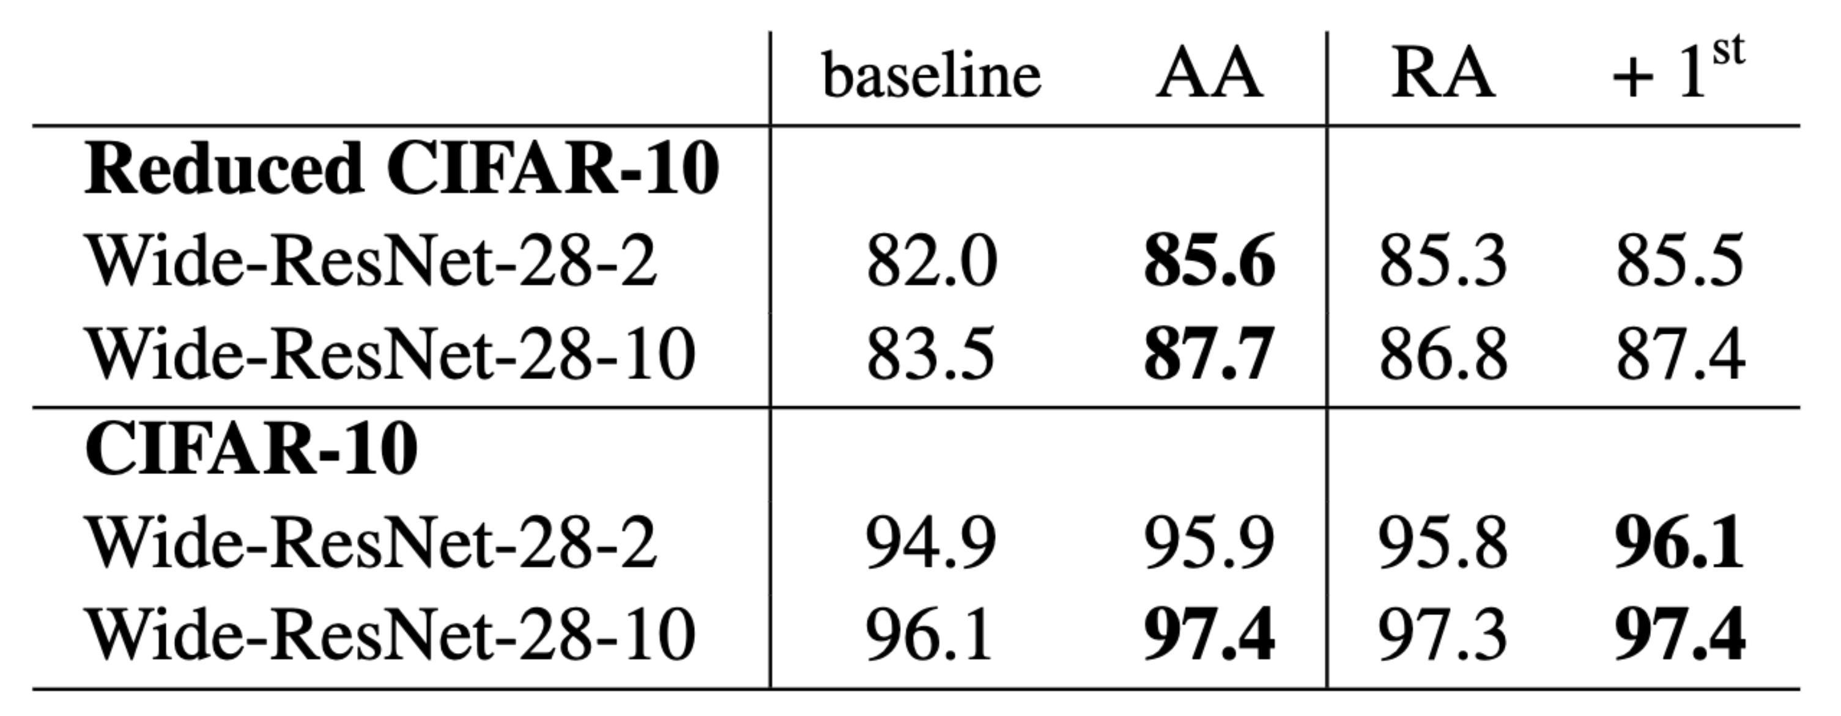
Results
Learning the probability per augmentation
Improves performance
Higher computational demands
Requires to apply all K transformations N times to each image
Notes:
Always better than RandAugment
Has high computation cost
Tradeoff interesting
Future work

Slide 14
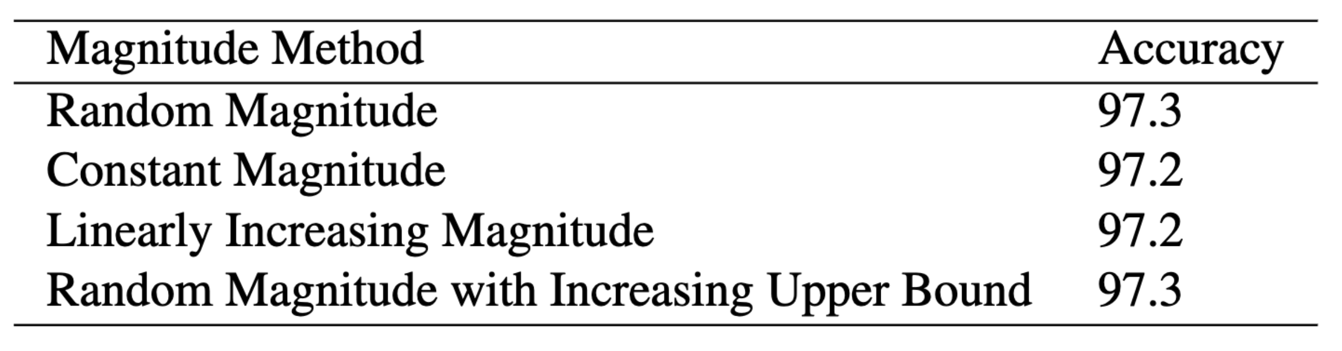
Results
Magnitude methods
Ways to choose the magnitude
Similar performances
Notes:
Can also change the way we assign the magnitude
Random = random between min and max
Constant = one value at init
Linearly = interpolation between two values
Random linear = random but with upper bound changing during training
Constant for its simplicity and less parameters

Slide 15
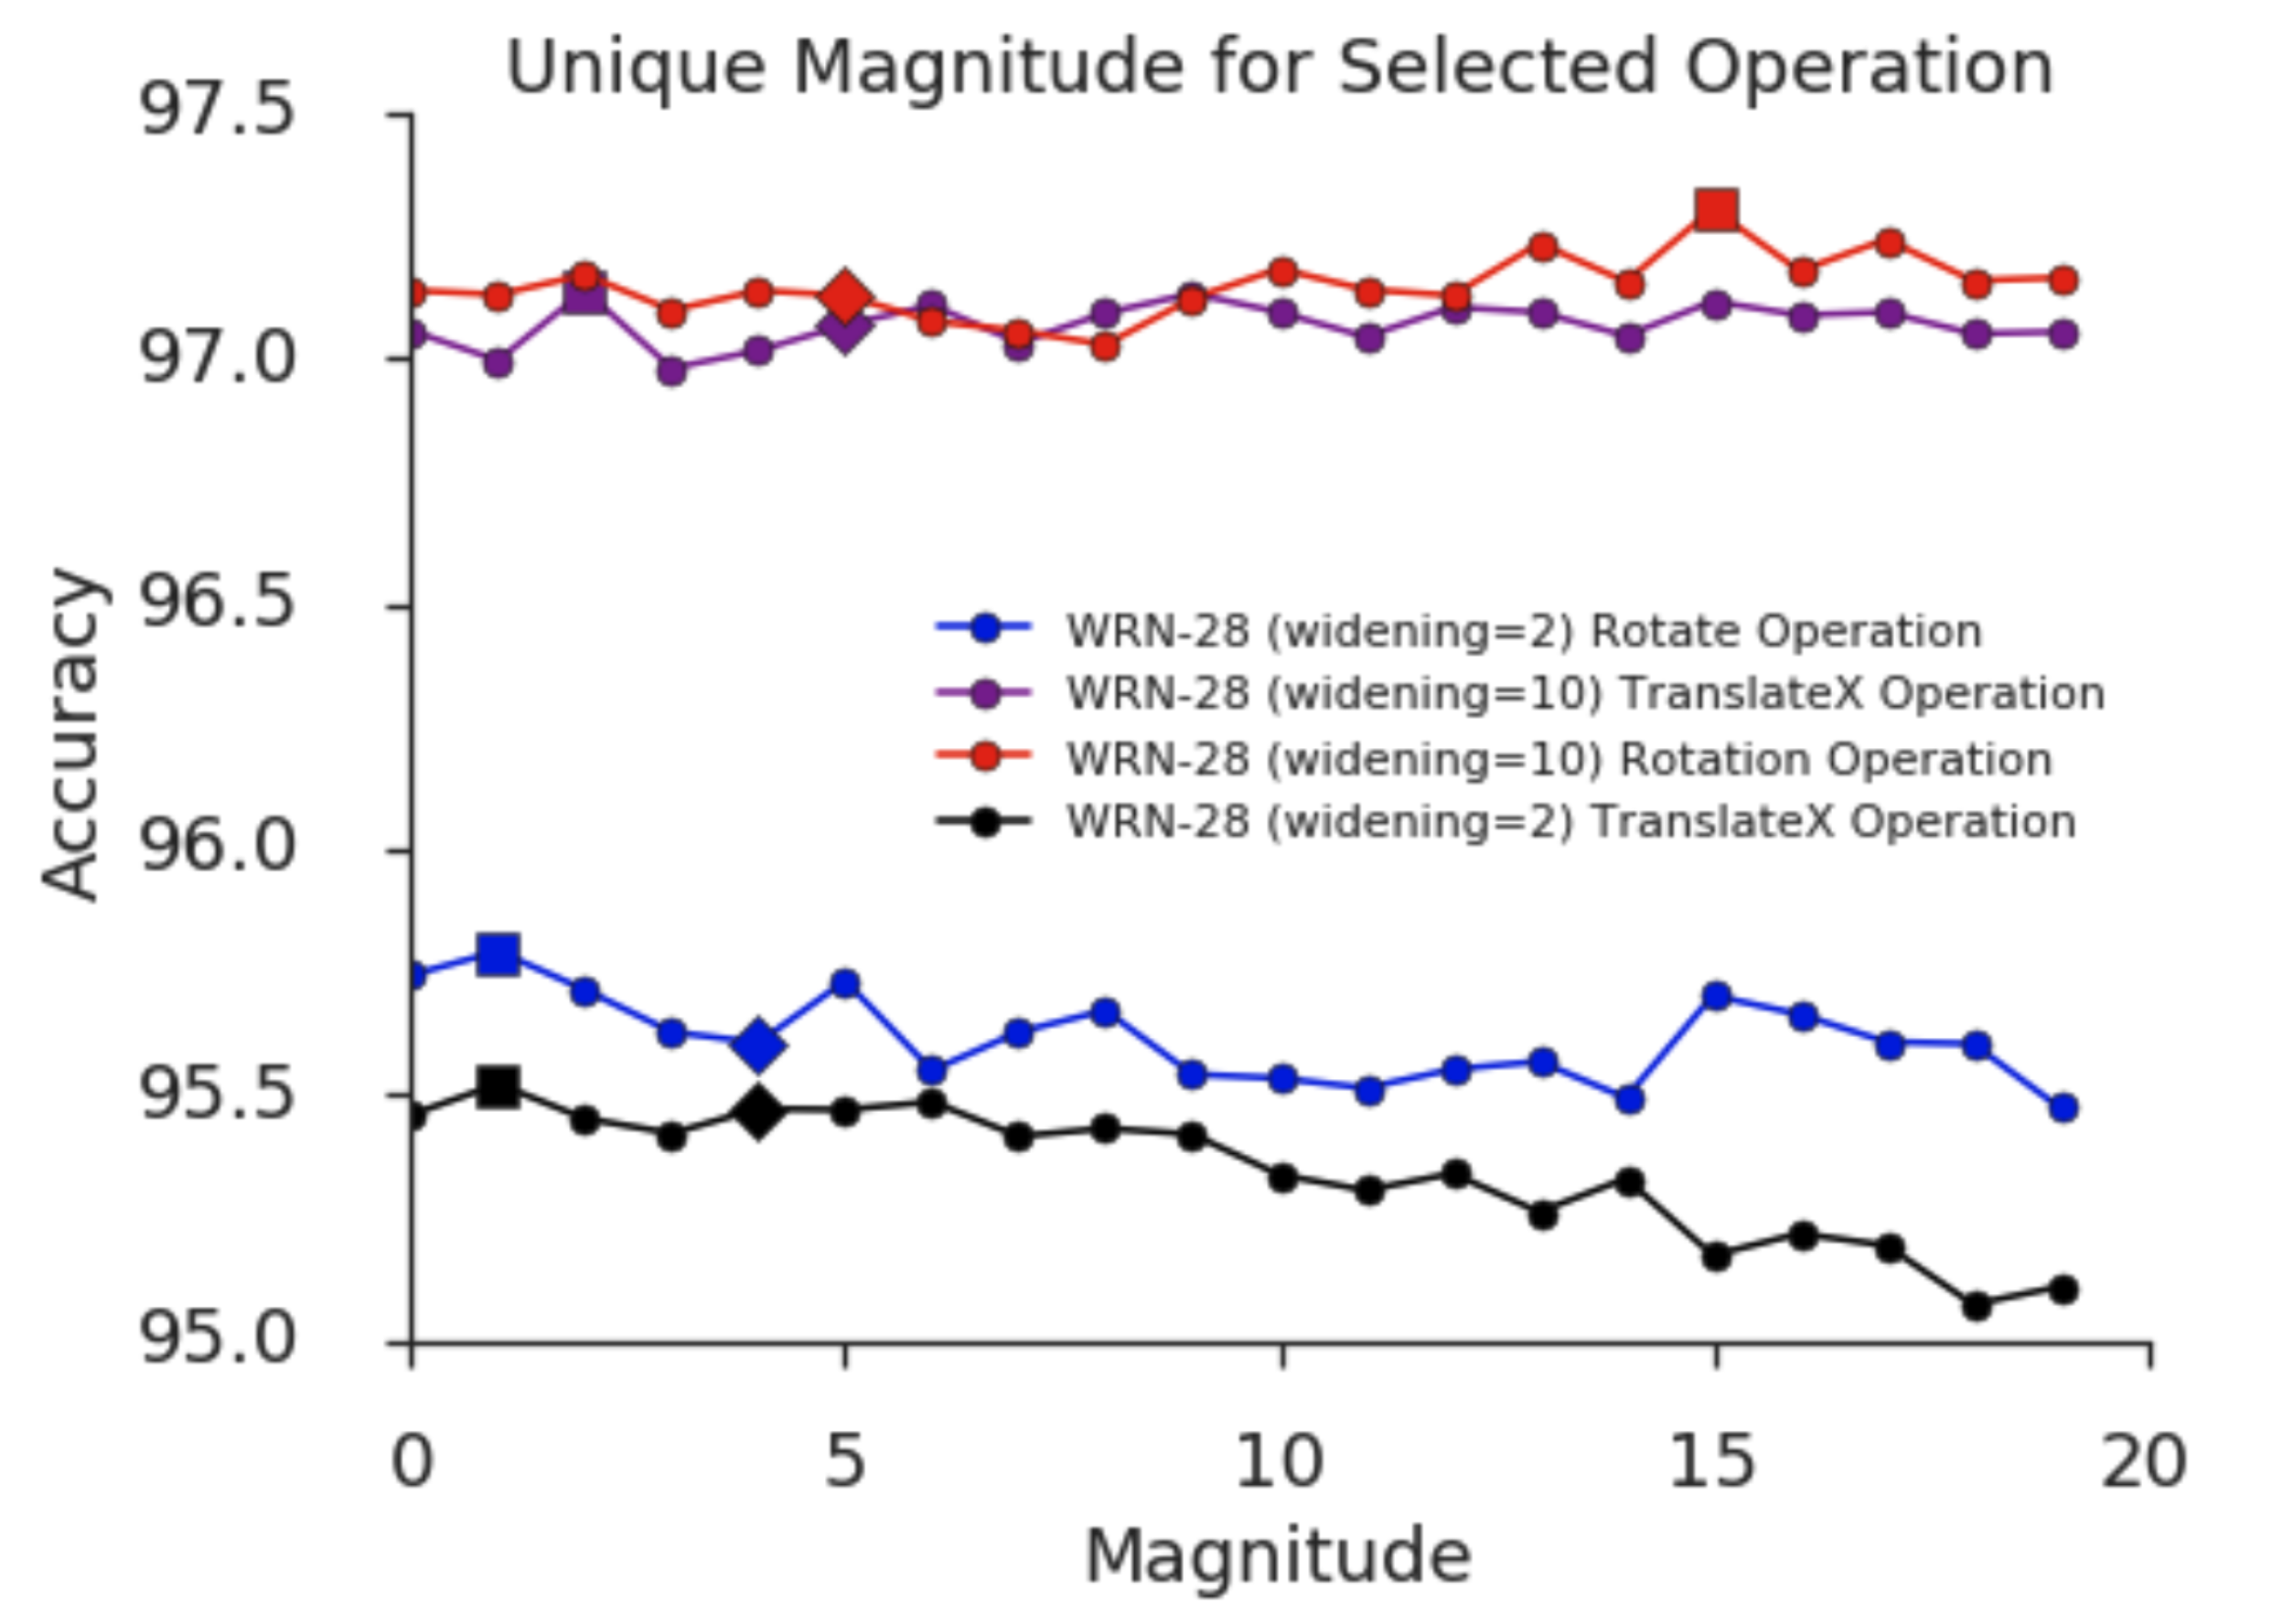
Results
Individual magnitude
Notes:
Similarly, study impact of changing magnitude per transform
Results for different network size
Only changing one opearation
Not much change

Slide 16

RangAugment

Slide 17
Questions?

